Slide 1
Deep Learning for Intrusion Detection in Reconfigurable Wireless Network
Student Name-(Reg No)
Student Name-(Reg No)
Student Name-(Reg No)
Student Name-(Reg No)
Student Name-(Reg No)
Student Name-(Reg No)
Guide Name

Slide 2
Problem Statement​
The rise of Reconfigurable Wireless Networks (RWNs) has brought tremendous advancements in wireless communications, offering increased scalability, flexibility, and dynamic topological reconfiguration. However, with these benefits come significant security challenges. The dynamic nature of RWNs, including diverse communication protocols and continuously changing network topologies, opens up vulnerabilities to sophisticated cyber threats such as Denial of Service (DoS) attacks, unauthorized access, and spoofing. Traditional intrusion detection systems, which rely on static rule-based methodologies, struggle to address these evolving threats. To ensure the integrity and reliability of next-generation wireless networks, there is a need for an advanced intrusion detection system that can adapt to the dynamic characteristics of RWNs, utilizing modern deep learning models to classify and detect a broad range of attacks.

Slide 3
Objectives
To develop a Deep Learning-based Intrusion Detection System (DL-IDS) to secure Reconfigurable Wireless Networks (RWNs).
To implement both binary and multi-level classification for identifying various types of attacks such as DoS, spoofing, and unauthorized access.
To optimize the intrusion detection system for resource-constrained environments typical of RWNs.
To enhance the accuracy and efficiency of intrusion detection using Convolutional Neural Networks (CNNs) combined with machine learning techniques.

Slide 4
Modularization of Project
Data Acquisition: Collect network traffic data from both normal and attack scenarios.
Preprocessing: Normalize and select features to prepare the data for training deep learning models.
Binary Classification: Classify network traffic as normal or malicious.
Multi-Level Classification: Identify the specific type of attack, such as DoS, R2L, U2R, or Probe.

Slide 5
Data Pre-processing Steps
Clean the Data: Remove any rows with missing values or irrelevant columns that do not contribute to identifying attacks.
Normalize the Data: Scale numerical features (like byte counts, connection durations) to ensure they are on the same scale, so no feature dominates the model.
Encode Categorical Data: Convert text-based features (like protocol type and service) into numbers using techniques like label encoding or one-hot encoding.
Select Important Features: Identify and keep the most relevant features that help in detecting attacks using techniques like correlation analysis.
Split the Data: Divide the dataset into training and testing sets, typically 80% for training and 20% for testing, to ensure proper evaluation of the model.

Slide 6
Design Methodology
Data Collection: Gather real-time traffic data from various network connections.
Feature Preprocessing: Normalize data and perform feature selection to ensure only the relevant information is used for model training.
Deep Learning Model: Use CNNs integrated with other ML techniques like Support Vector Classifiers (SVC) and Gaussian Naïve Bayes to detect complex attack patterns.
Optimization: Apply techniques like dropout and hyperparameter tuning to ensure model performance within resource-limited environments.
Continuous Learning: Implement adaptive learning to recognize new and emerging threats.

Slide 7
Project Demonstration
Real-Time Traffic Detection: Demonstrate how the DL-IDS detects and classifies intrusions in real-time using live network data.
Attack Scenarios: Simulate various types of attacks (DoS, R2L, U2R, Probe) and show how the system classifies them.
Alert Mechanism: Showcase how the system sends instant alerts to network administrators upon detecting an attack.
Performance Metrics: Present the accuracy, precision, recall, and F1 scores achieved by the system for both binary and multi-level classifications.
Resource Optimization: Display the system's performance in environments with constrained resources

Slide 8
Test Case Specifications
Binary Classification: Evaluate the system's ability to correctly classify network traffic as either normal or malicious.
Multi-Level Classification: Test the system’s accuracy in identifying the specific type of attack (DoS, R2L, U2R, Probe).
Real-Time Alerts: Simulate attack scenarios to verify the system’s ability to send timely alerts to administrators.
Performance in Resource-Constrained Environments: Assess the model's efficiency under limited computational resources typical of RWNs.
Accuracy and Recall: Measure the overall effectiveness of the system through metrics like accuracy, precision, recall, and F1 score.

Slide 9
System Requirements
Hardware Requirements
Processor & RAM: Minimum Intel Core i5, 8GB RAM (Recommended: Intel Core i7 / Ryzen 5, 16GB RAM).
Storage & GPU: 500GB+ storage (Recommended: SSD),
Peripherals: Standard keyboard, mouse, and display for interaction.
Software Requirements
OS & Frameworks: Windows 10 / Linux (Ubuntu 20.04+) / macOS, ReactJS (Frontend), Flask (Backend).
Development & Database: Python 3.x, PyCharm/VS Code
DL Algorithms : Scikit-learn for text processing, Git for version control.

Slide 10
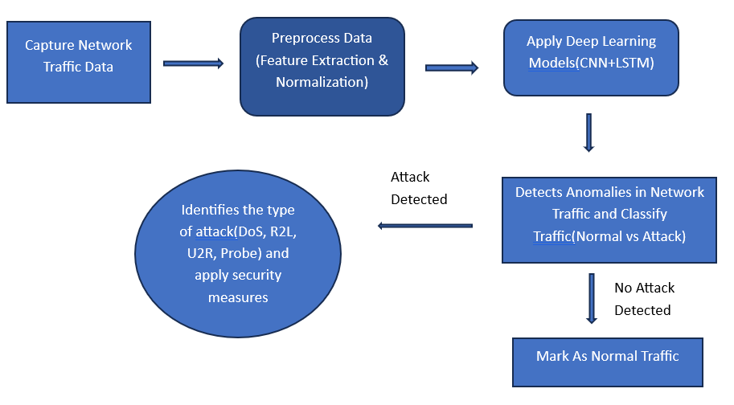
System Architecture

Slide 11
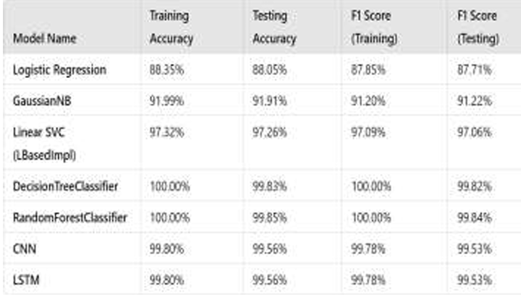
Results

Slide 12
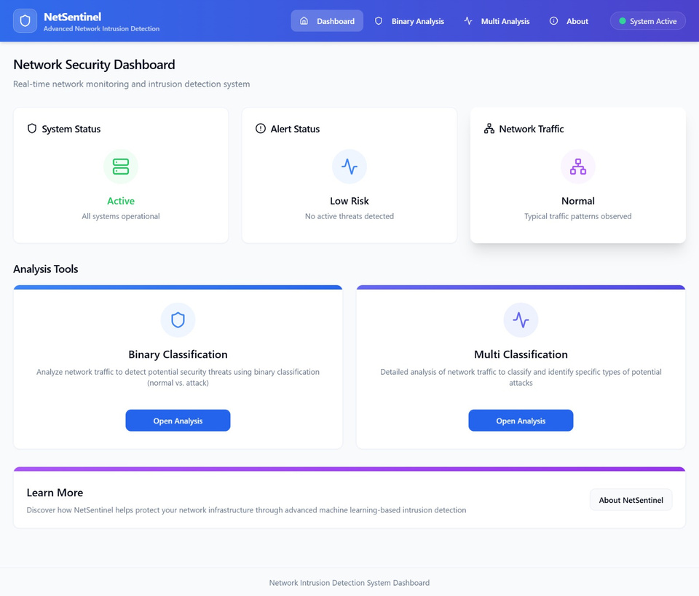
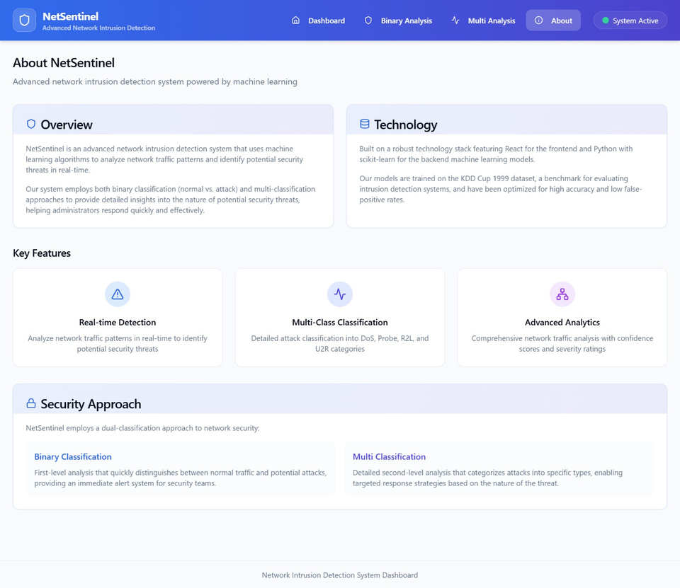
Results

Slide 13
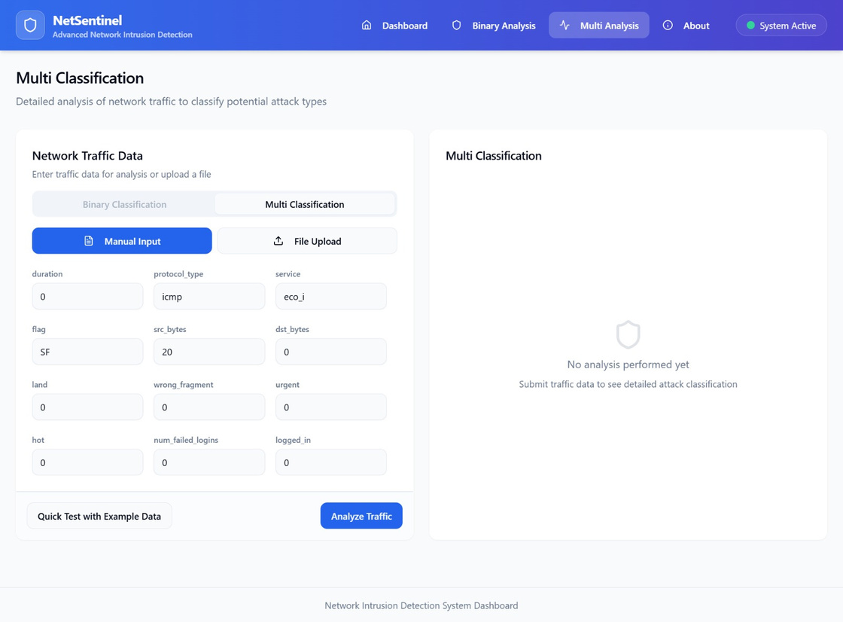
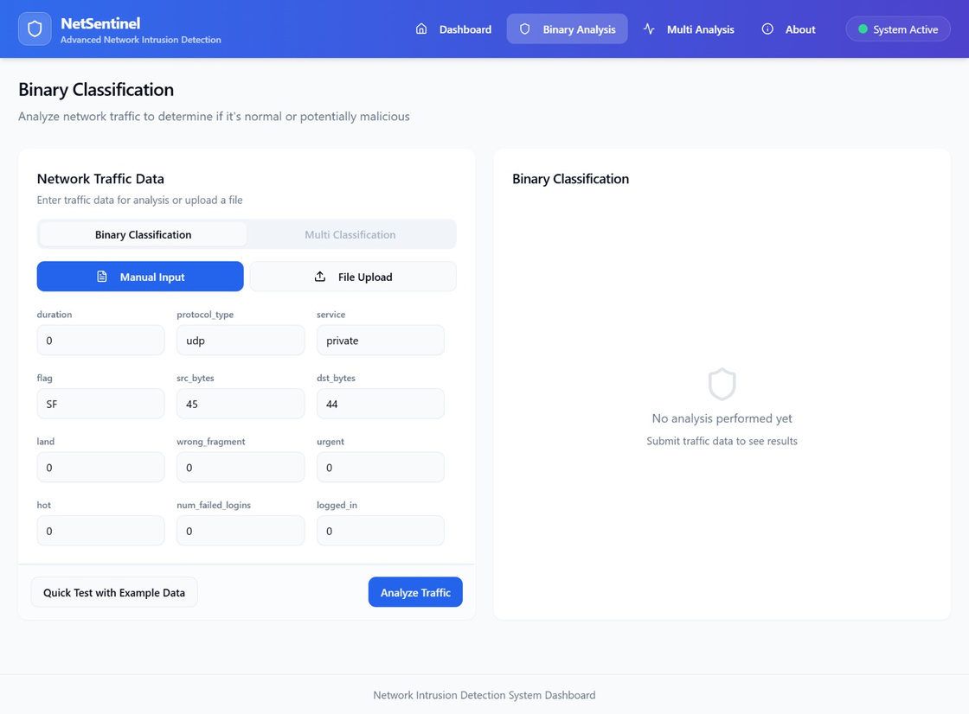
Results

Slide 14
Conclusions
The proposed Deep Learning-based Intrusion Detection System (DL-IDS) provides an effective and scalable solution for detecting threats in Reconfigurable Wireless Networks (RWNs). By using advanced models like CNNs and RNNs, it accurately classifies network traffic and identifies various attacks, including DoS and unauthorized access. Optimized for resource-limited environments, the system ensures real-time detection and alerts, enhancing security for next-gen wireless networks. Future improvements in classification and deep learning models will further refine its performance.
Future Scope
The system can be enhanced by improving multi-level classification using advanced architectures like transformers or hybrid CNN-LSTM models. It can be scaled to accommodate larger, more complex networks, including 5G environments. Integration with existing network management tools for automated responses will increase its efficiency. Continuous learning will help the system adapt to emerging attack patterns, and further optimization can improve real-time detection and response times.

